Slide 1
NEW APOSTOLIC CHURCH BURIAL FUND NAMIBIA:
INFORMATION PRESENTATION
1 JULY 2020

Slide 2
INTRODUCTION
Our Namibian Burial Fund members up to 30 June 2020 has been covered by a burial policy underwritten by Liberty Life Namibia;
Negotiations with this service provider, in respect of premium rates for the 2020-2021 period, became excessive, especially for our over-65-year-old members;
It was therefore decided by the Burial Committee to seek alternative means of burial cover for our members;
As from 1 July 2020, after considering various options which would serve to the benefit of our members, we are pleased to advise that the new service provider of choice is Hollard Life Namibia.
Slide 2 of 11

Slide 3
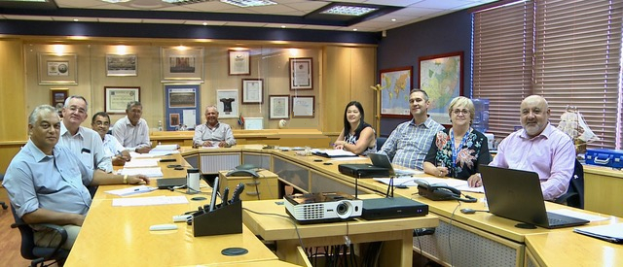
NAC BURIAL FUND EXECUTIVE COMMITTEE

Slide 4
SUMMARY OF FUND DETAILS
Eligibility: The following age categories will be covered by the policy:
Minimum age for a main member is 18 years old and maximum age is 65;
Once a child dependent reaches 21 years they will have to be insured on their own separate policy;
A child registered at an educational institution will be covered until age 25;
Financially dependent child of the main member who is mentally disabled or permanently disabled.

Slide 5
FUNERAL COVER BENEFITS
Main member: NAD 20 000
Spouse: NAD 20 000
Child 14-21 years: NAD 20 000
Child 6-14 years: NAD 10 000
Child 2-6 years: NAD 5 000
Child 2-6 years: NAD 5 000
Child 0-2 years: NAD 5 000

Slide 6
IMPORTANT TO NOTE:
Time period for notification of death within 6 months from date of death.
Send evidence and other documents within 3 months of death
There are no waiting periods for new members, and no health questionnaires to be completed.
Funeral claim forms can be obtained from Hollard offices.

Slide 7
ANNUAL PREMIUMS
Annual Premiums for 2020/2021, NAD 370 per member per annum;
The Annual Premium continues to be subsidized by the NAC Burial Fund.
Annual Premium payment procedures remain the same as in previous years.

Slide 8
WHAT TO DO IN THE EVENT OF A CLAIM?
The process remains the same.
A member has the following options in the event of a claim:
Contact a NAMBOB undertaker for assistance or,
Once the cash benefit has been paid out, choose an undertaker of own choice;

Slide 9
HOLLARD LIFE NAMIBIA CONTACT DETAILS
Telephone number: +264 61 422 339
Email address: Bvandenberg@hollardnam.com
Offices:
Jan Jonker Heights Commercial Suite
Corner Jan Jonker & Thorer Road
Windhoek, Namibia
Slide 10 of 11

Slide 10
CLOSING
E-MAIL QUERIES TO:
burial@nac-sa.org.za

Slide 11
END OF PRESENTATION

